Slide 1




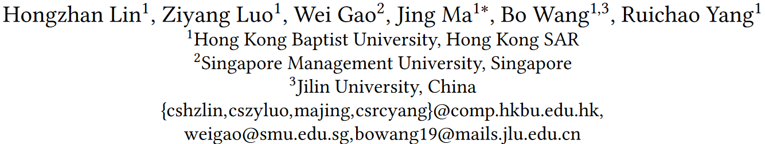





ATAI
Advanced Technique of Artificial Intelligence
ATAI
ChongqingUniversity _{AdvancedTechniqueof}
of Technology Artificial Intelligence
Chongqing University of Technology
Chongqing University ^{ATAI}
_{of Technology} Advanced Techniqueof
Artificial Intelligence
Chongqing University of Technology
Chongqing University of Technology
Towards Explainable Harmful Meme Detection through Multimodal Debate between Large Language Models
code:https://github.com/HKBUNLP/ExplainHM-WWW2024.
—— WWW ’24
Reported by Shu Ming Jiang
1

Slide 2
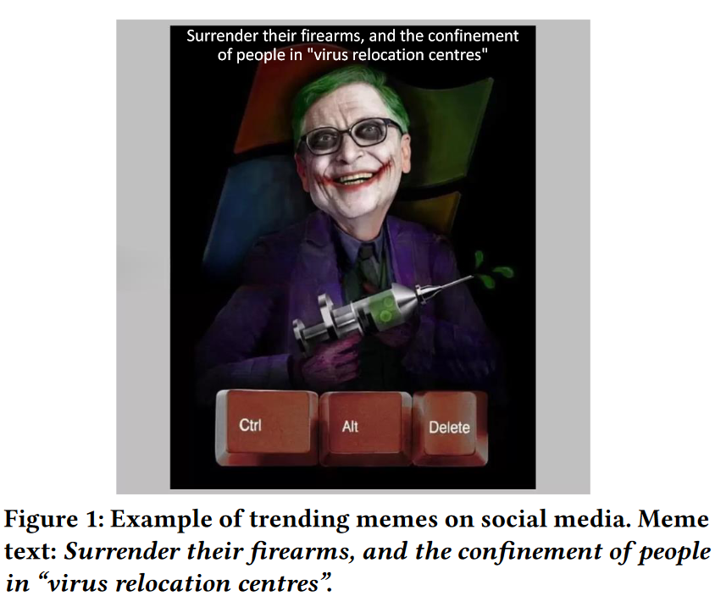
ATAI
Advanced Technique of
Artificial Intelligence
ATAI
ChongqingUniversity _{AdvancedTechniqueof}
of Technology Artificial Intelligence
Chongqing University of Technology
Motivation
1)However, these approaches for harmful meme detection only capture superficial harmfulness patterns for classification in a black-box manner , which often overlooks or oversimplifies the supportive basis to explain the final harmfulness prediction.
2)In contrast, conventional detection models lack such natural sentences with multimodal reasoning chains, hindering their ability to provide informative explanations for harmfulness predictions.

Slide 3
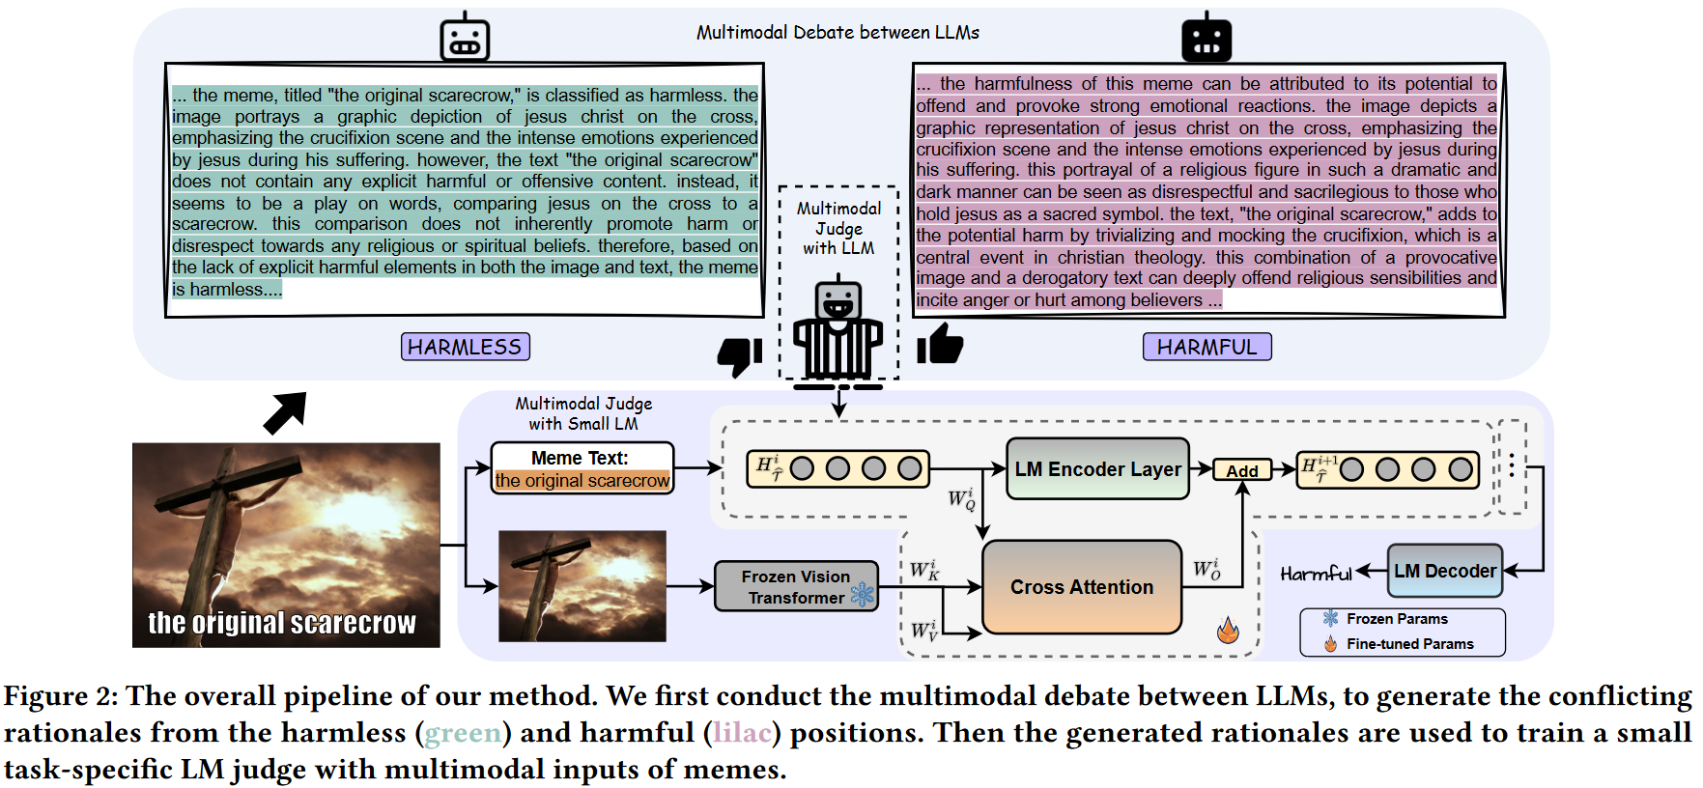
ATAI
Advanced Technique of
Artificial Intelligence
ATAI
ChongqingUniversity _{AdvancedTechniqueof}
of Technology Artificial Intelligence
Chongqing University of Technology
Overview

Slide 4

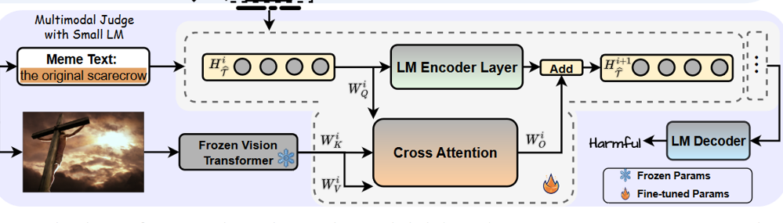




ATAI
Advanced Technique of
Artificial Intelligence
ATAI
ChongqingUniversity _{AdvancedTechniqueof}
of Technology Artificial Intelligence
Chongqing University of Technology
Method

Slide 5
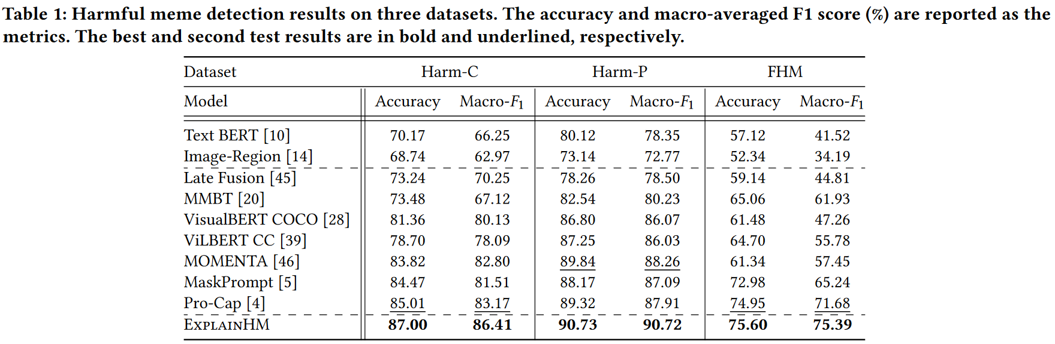
ATAI
Advanced Technique of
Artificial Intelligence
ATAI
ChongqingUniversity _{AdvancedTechniqueof}
of Technology Artificial Intelligence
Chongqing University of Technology
Experiments

Slide 6
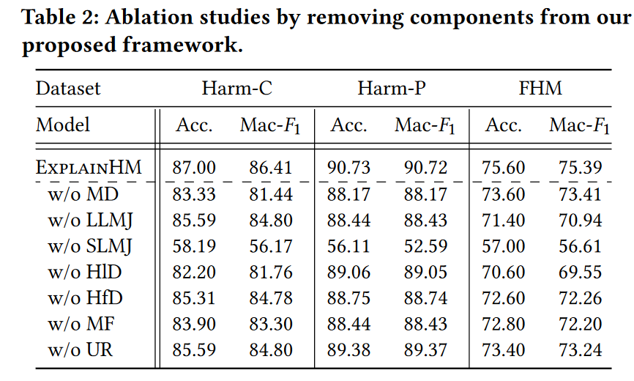
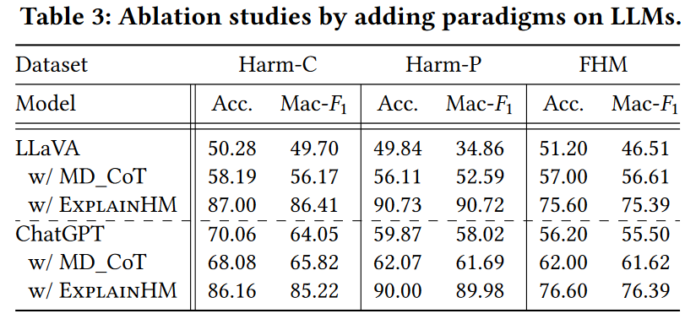
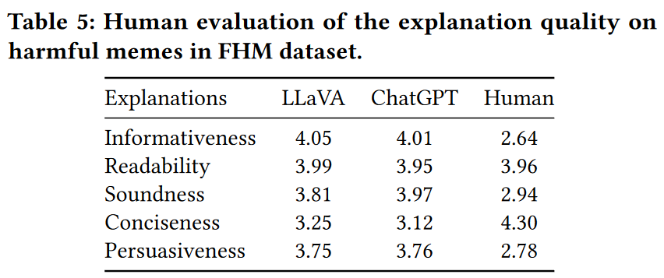
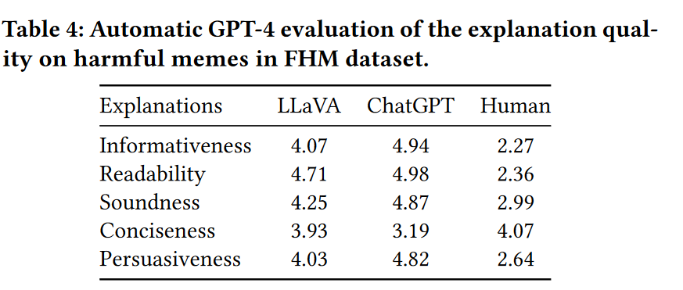
ATAI
Advanced Technique of
Artificial Intelligence
ATAI
ChongqingUniversity _{AdvancedTechniqueof}
of Technology Artificial Intelligence
Chongqing University of Technology
Experiments

Slide 7
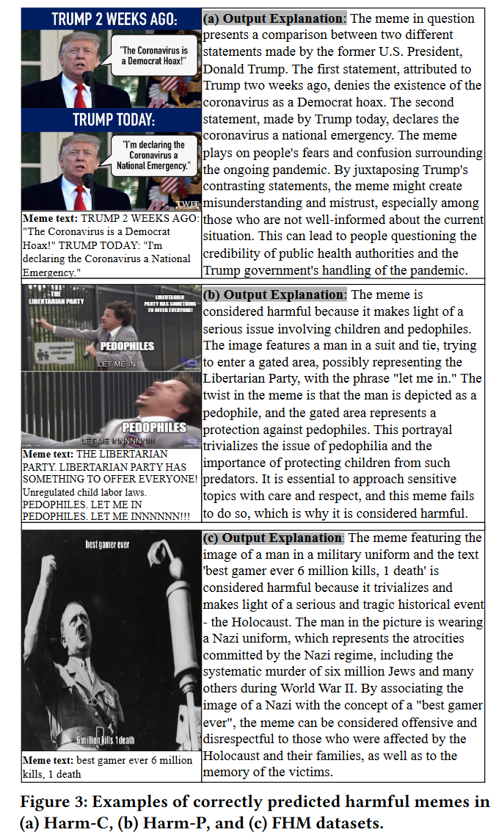
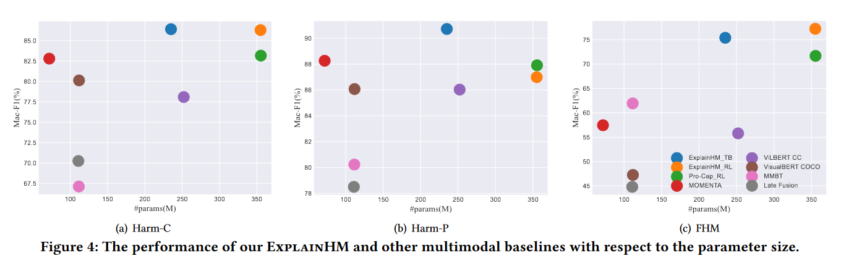
ATAI
Advanced Technique of
Artificial Intelligence
ATAI
ChongqingUniversity _{AdvancedTechniqueof}
of Technology Artificial Intelligence
Chongqing University of Technology
Experiments

Slide 8


ChongqingUniversity of Technology
ATAI
Advanced Technique of
Artificial Intelligence
ATAI
ChongqingUniversity _{AdvancedTechniqueof}
of Technology Artificial Intelligence
Chongqing University of Technology
Thanks!

